Slide 1

Student and Parent Orientation
Grades 9-12
2025-2026
Notes:
6/3/21

Slide 2

PFE Goals
Ease isolation and loneliness of the elderly by promoting connection.
For students and mentors to create intergenerational relationships and experience the blessing of service.
Support Adventist Education by awarding tuition scholarships
Legacy Video

Slide 3
PFE is for students who are:
Passionate about service
Intentional and creative with their visits/service
Committed to visiting a mentor 2 hours weekly
A student who values Christian education

Slide 4
How it works
Find a mentor who fits the PFE profile
Complete a 2-hour visit each week,
  for 14 weeks each term
      Fall Term: August 17- December 31
      Spring Term: January 1 – May 15
Submit reflection online/phone app during visit.
  late reflections will be rejected
  $800 PFE scholarship awarded
  each term requirements are met!

Slide 5
Choosing Your Mentor
Who does NOT live in a nursing home
Who can commit to 2 hours every week for 14 weeks each term.
With whom you can form a relationship, have similar interests/hobbies
Who is NOT related to you by any degree
Who is cognitively healthy (no Alzheimer’s or dementia)
Who might be lonely and is needing company
Age 55+ recommended (can be under 40 if they have a physical disability)

Slide 6
Apply for a Student Account
Go to pfe.sffcfoundation.org
Click "Student Application"
Complete the application (you must have your mentor’s information for this step)
Once your school coordinator approves your account, you will receive an email prompting you to complete account creation by selecting a password
Follow the link and choose your password
Log in
You will be prompted to complete your entry survey when you submit your first reflection

Slide 7
Schedule Your Visits
Once your application has been approved by your Coordinator you may start your weekly visits.
Start your weekly visits!
  Only 1 visit is allowed each week.
There are 20 weeks in each term to complete your 14 weeks of visiting your mentor.
”Make-up” visits are NOT allowed, even if you or your mentor becomes sick or is out of town for vacation.
Decide with your parents, if they will visit with you or allow you to go alone (transportation to/from visit is your parent's responsibility).

Slide 8

Visiting
Discuss with your mentor what activities he/she would like to do during your visit together.
Be on time, and let your mentor know ahead of time if you need to reschedule.
The ideas are endless! Work with your mentor to see what activities fit best for both of you.

Slide 9
Unacceptable Activities
Virtual Visits
Visits during Sabbath hours
Visiting your mentor’s home while he/she is away
Sharing a mentor with another student or having multiple mentors
Time spent at a school event, cleaning church/school, assisting in classroom, being at a place of employment with your mentor, entertainment venue, etc.

Slide 10
Reflect on Your Visit
Login to your PFE account or PFE app
Click “Submit New Reflection”
Fill out the form and submit, uploading any pictures you'd like to share
Check for successful submission (will receive email/text)
Your coordinator will review, then approve or reject your reflection
  If approved, you will receive an email/text confirmation.
  If rejected, you will receive an email. You need to edit and re-submit your reflection for this visit date (within 2 weeks of original submission date)
  Only "approved" visits/reflections count toward scholarship
For tech issues you must notify your coordinator immediately.
Delayed notification is not acceptable.

Slide 11
Reflections
Submit using the PFE website or download the PFE app
Submit reflection DURING your visit
Check your PFE dashboard or email/text alert for submission success
Students and Coordinator will receive email notifications with each successful reflection transaction.
Be very detailed when answering your reflection questions.
Late reflections will be rejected

Slide 12
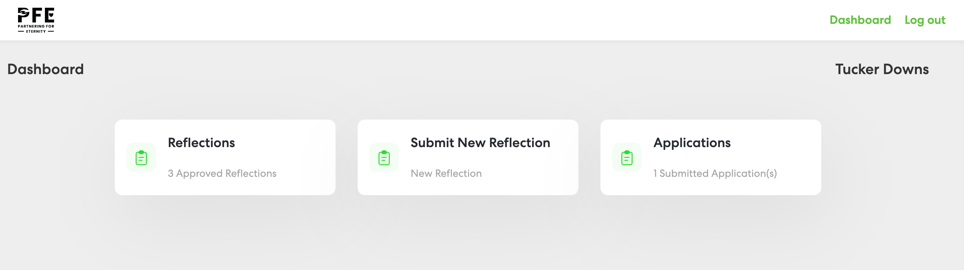
PFE Student Dashboard

Slide 13
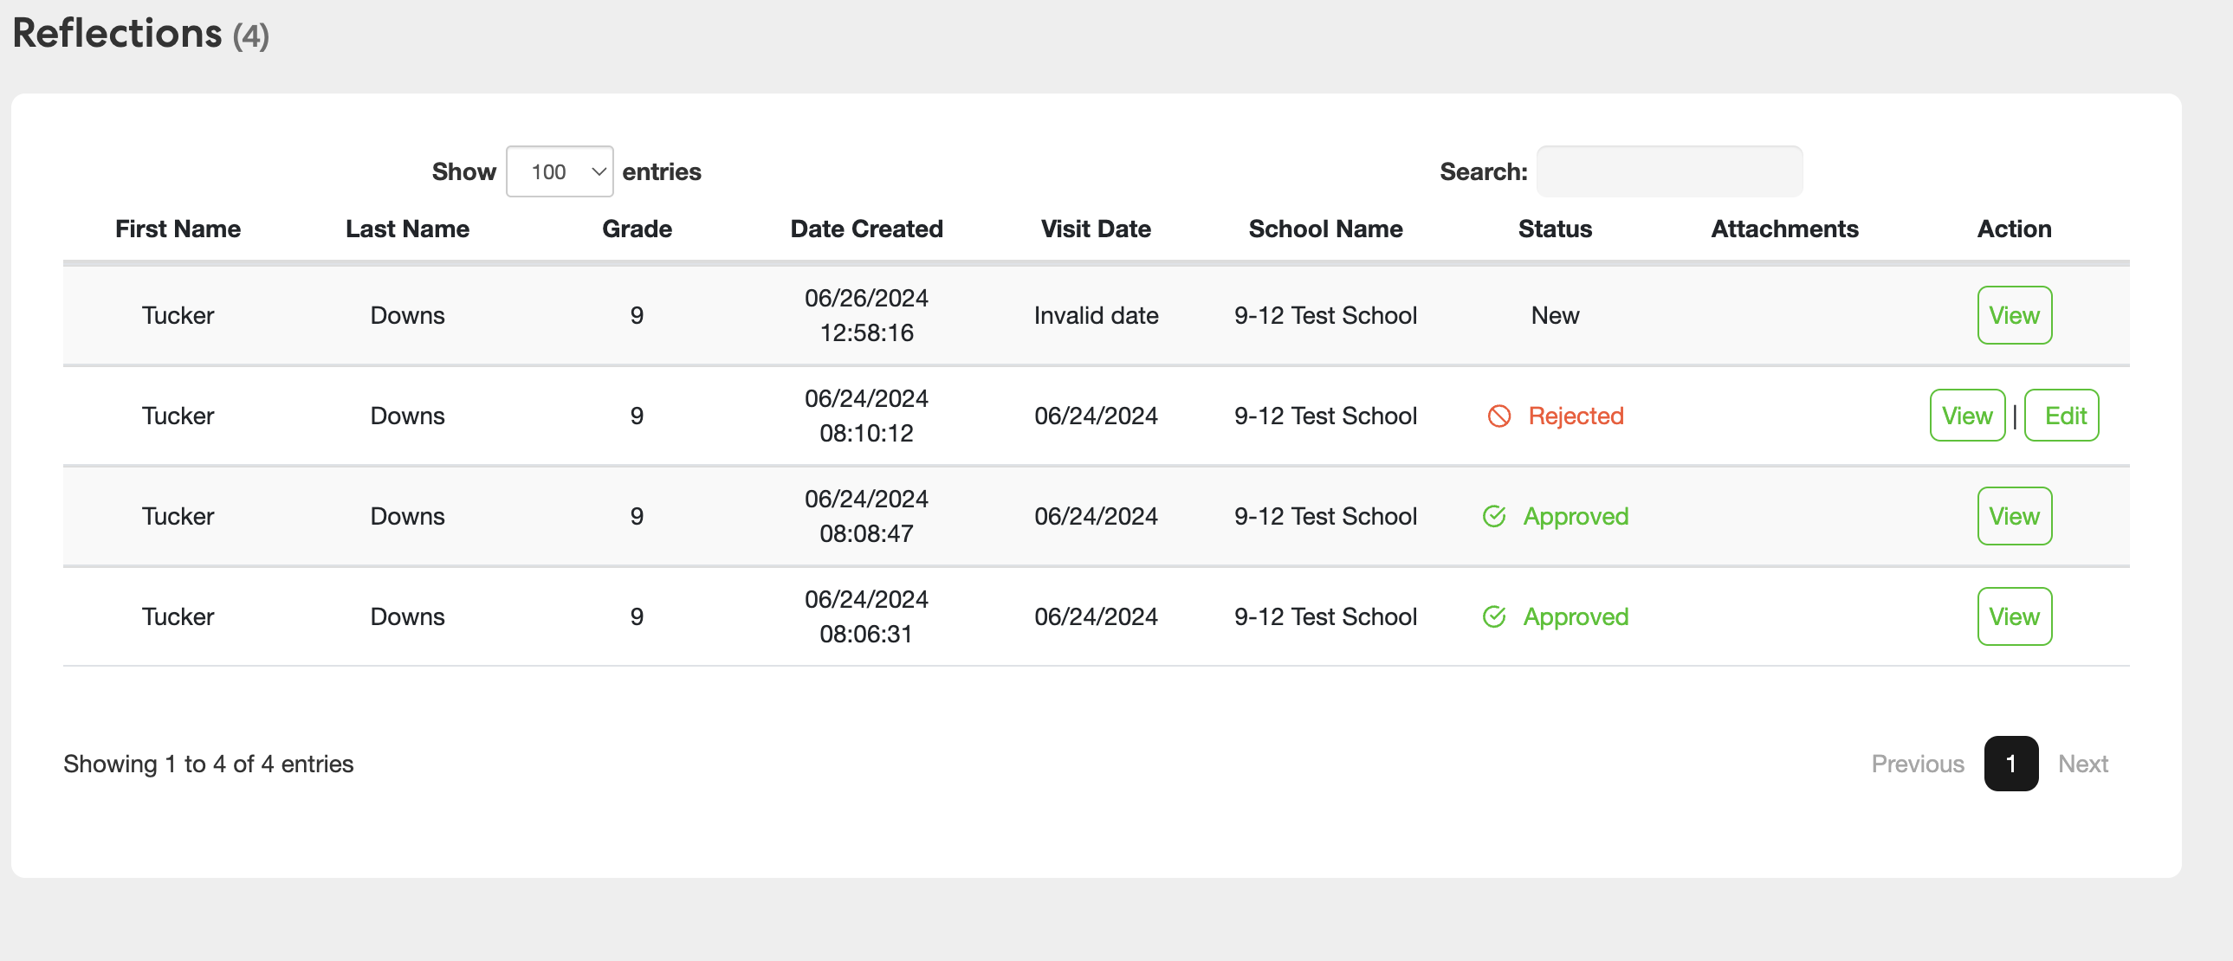
Student Reflection Log

Slide 14
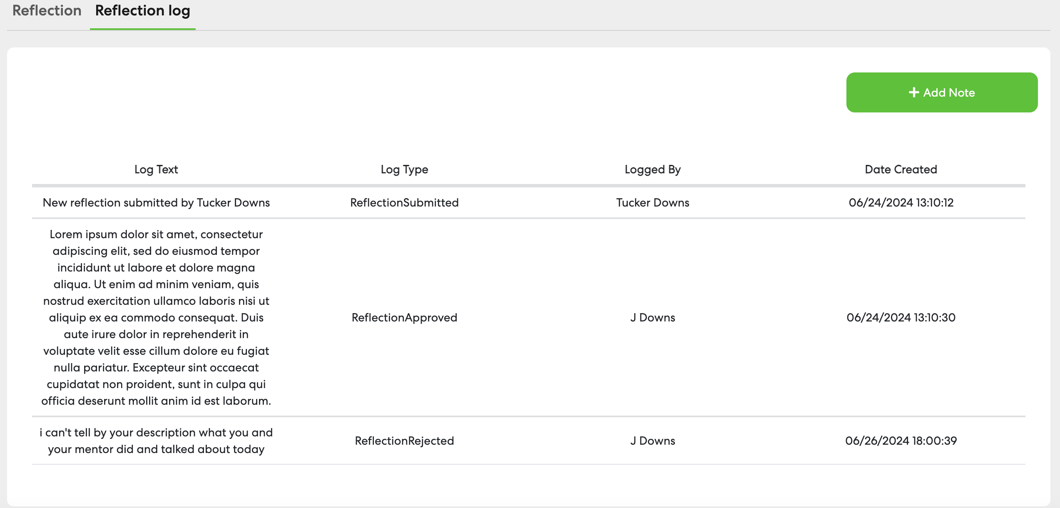
Reflection Log

Slide 15

Safety
Parents of students in grades 9-12 must make their own decision about attending visits. You are ultimately responsible for your child’s safety.
Make sure you are complying with any of your conference’s policies for student safety, including background checks, if applicable.
Your school may require parents to sign a permission slip.

Slide 16
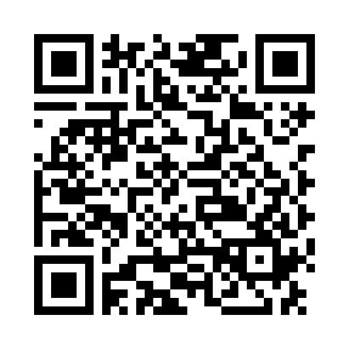
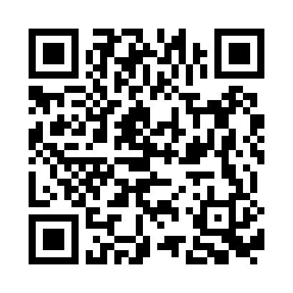
You’re Ready!
App
for iOS
Now available on the App store
App
for Android
Now available on the App store

